Slide 1

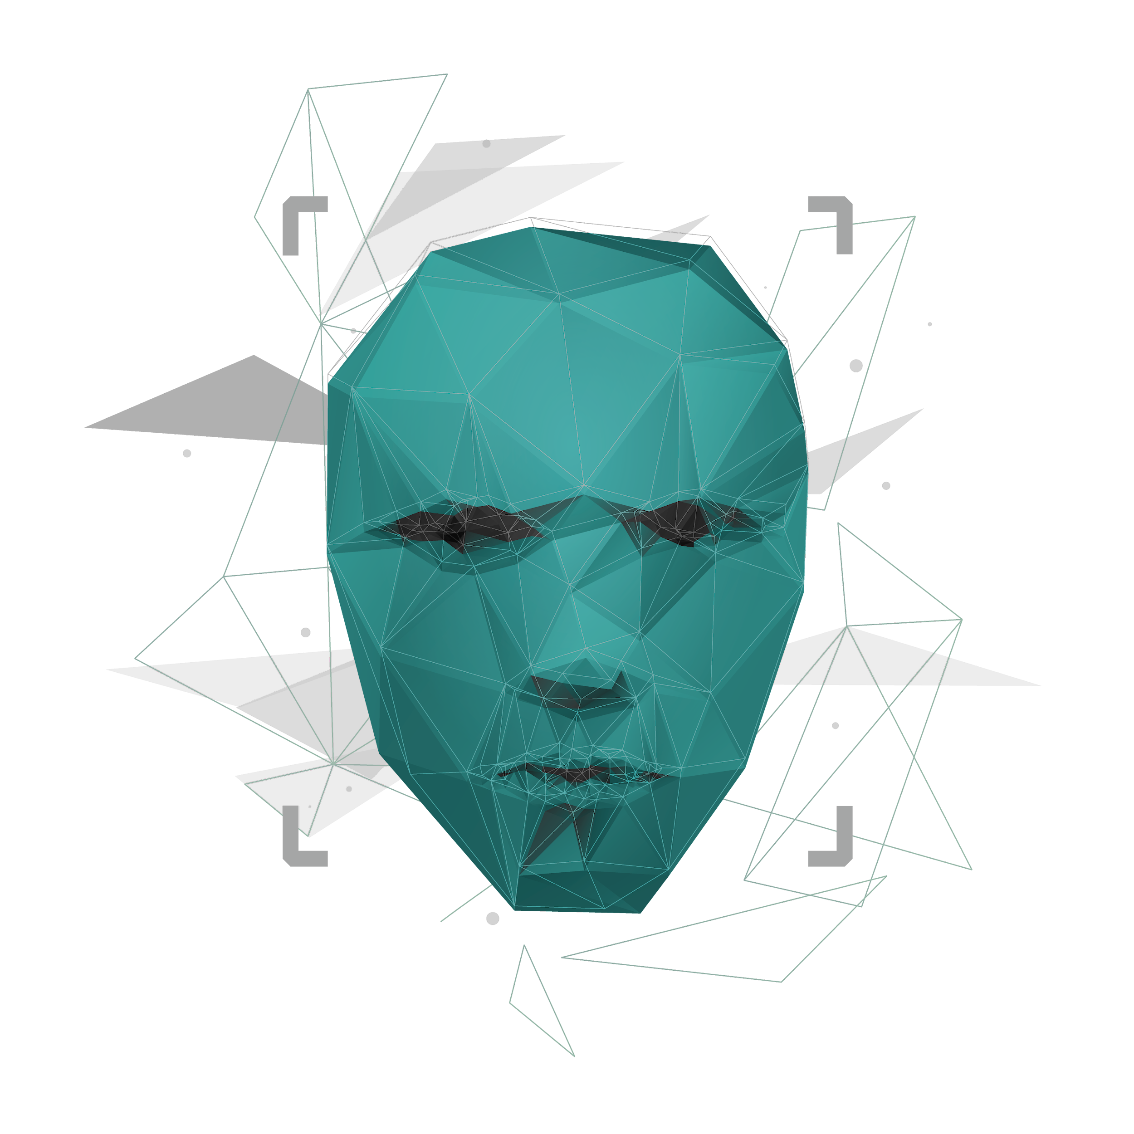
Multimodal Multimedia Integrity Verification – Detection ONOMA
Project ID : 24-25J-137

Slide 2

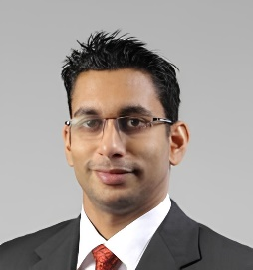

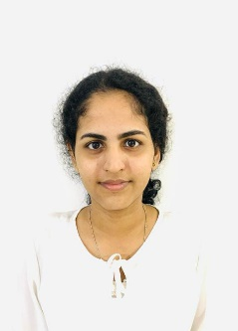


Meet The Team
MR.Kavinga Yapa ( Supervisor )
DR.Harindra Fernando ( Co-Supervisor )
ZAKEY M.S.M.A ( IT21299902 )
SHEHARA M.G.D( IT21305078 )
HASARA L.A.N ( IT21267086 )
DISSANAYAKE W.P.D.B ( IT21372308 )
(GL)
IT21299902 | ZAKEY M.S.M.A | 24-25J-137

Slide 3
Content
Introduction
01
Research Question
02
Objectives
03
Overall System diagram
04
Individual Components
05
IT21299902 | ZAKEY M.S.M.A | 24-25J-137

Slide 4
Introduction
The Multimodal Multimedia Integrity Verification system is an innovative solution designed to authenticate digital media and combat misinformation.
By employing cutting-edge machine learning and neural network technologies, the system detects deepfakes and altered content with high precision.
It ensures the credibility and security of audio, video, images and textual data, all while upholding ethical standards and protecting user privacy.
Deep Fake Audio Detection
Deep Fake Video Detection
Tampered Image detection
Fake News Detection
IT21299902 | ZAKEY M.S.M.A | 24-25J-137

Slide 5
Research Question
How can advanced machine learning and neural network techniques be leveraged to develop a reliable and scalable system for accurately detecting deepfake media Tampered images and fake news, while minimizing false positives and ensuring ethical data handling?
IT21299902 | ZAKEY M.S.M.A | 24-25J-137

Slide 6
Objective
To develop a scalable and robust framework for detecting deepfake audio, video, tampered images, and fabricated news content.
The Multimodal Multimedia Integrity Verification system leverages advanced machine learning and neural networks.
It aims to accurately identify anomalies while ensuring high accuracy and minimizing false positives, prioritizing ethical data handling to protect integrity, confidentiality, and privacy in digital communications.
IT21299902 | ZAKEY M.S.M.A | 24-25J-137

Slide 7
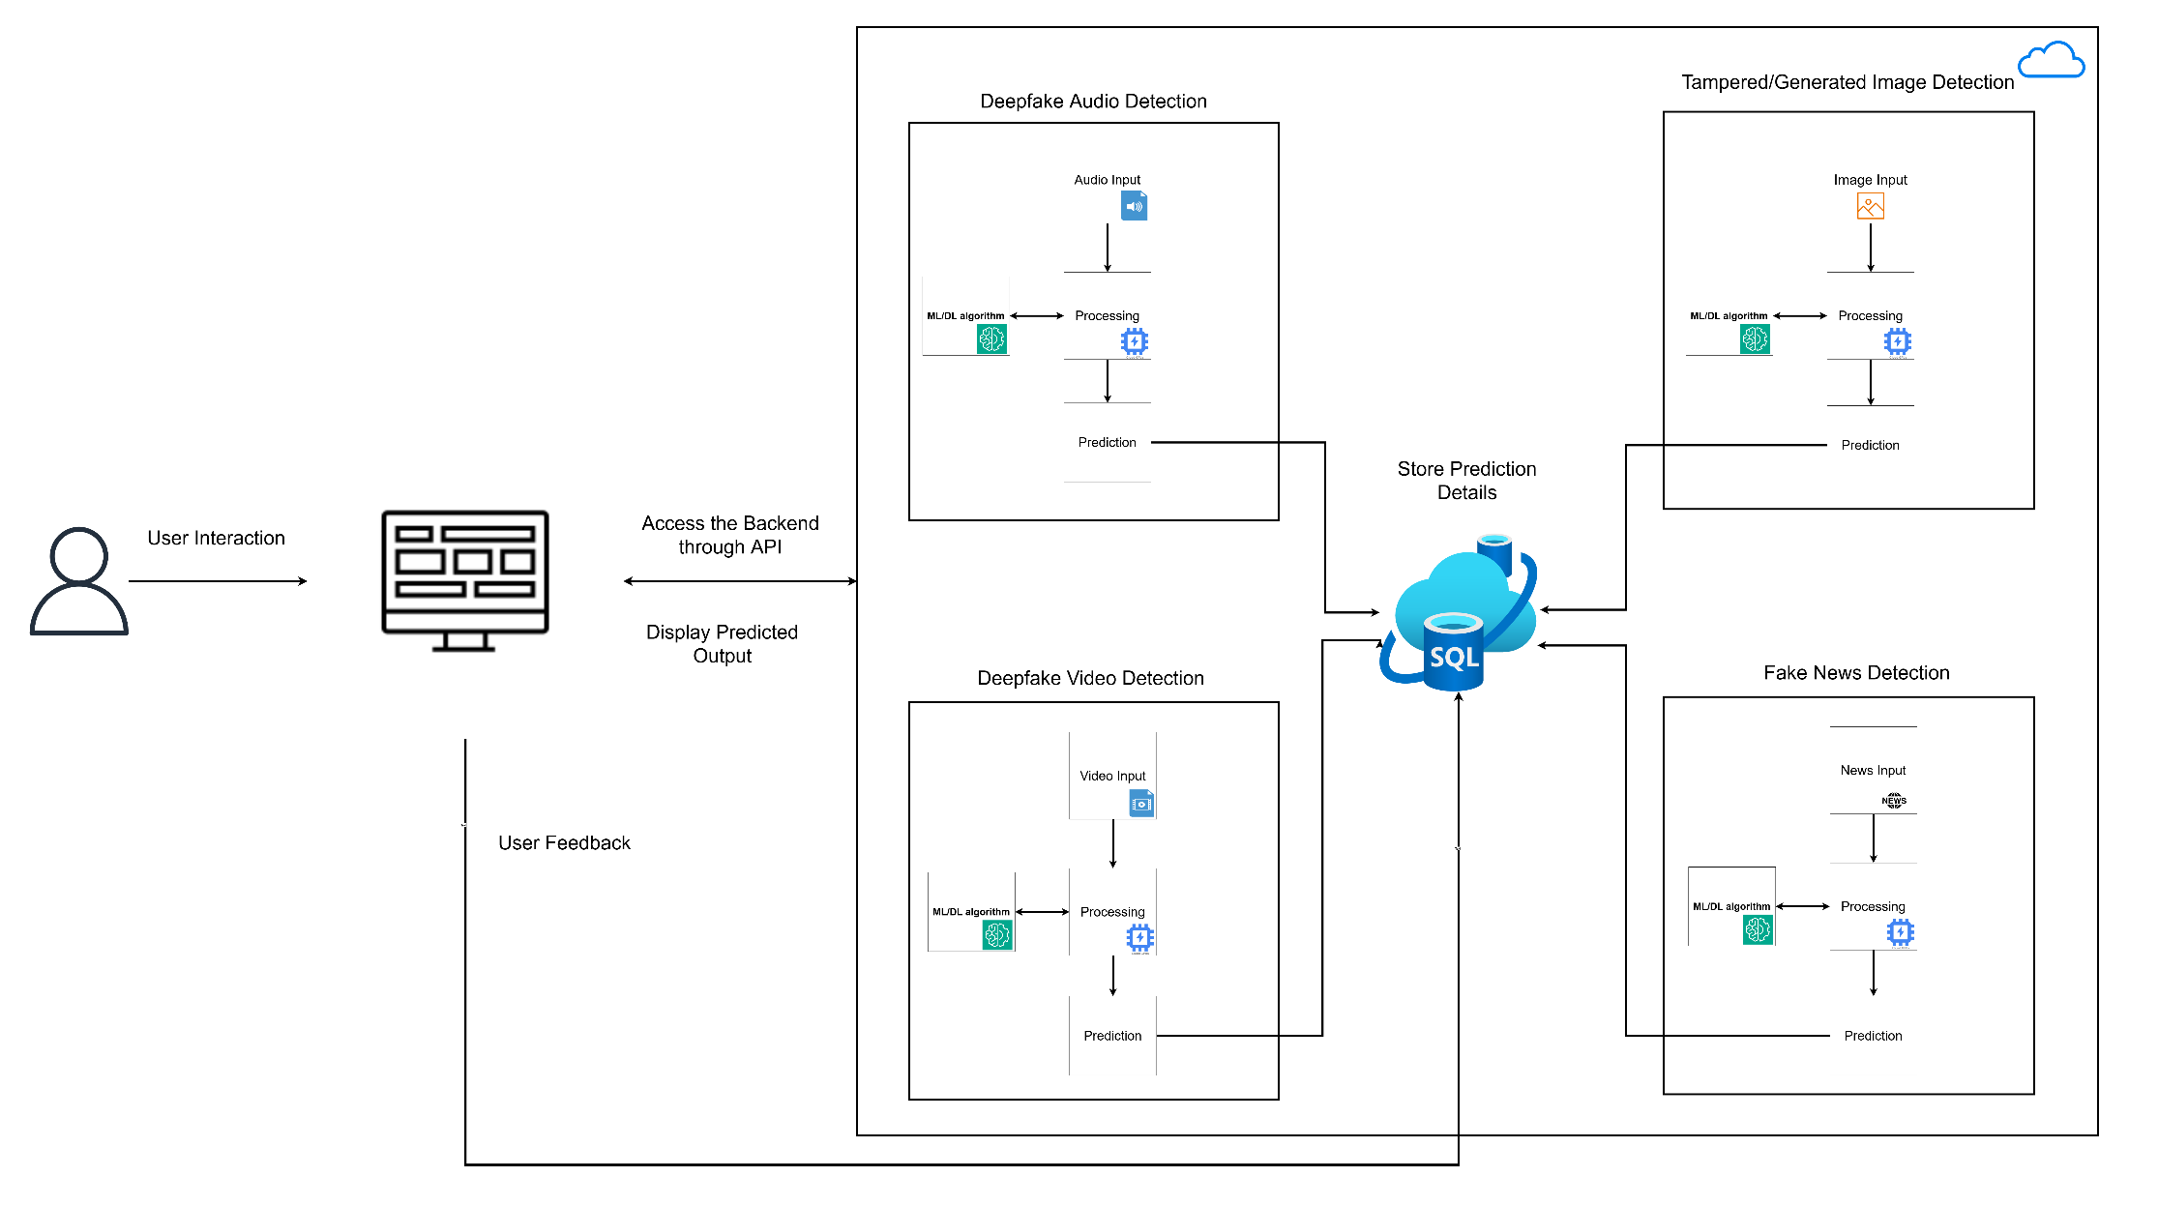
Overall System Diagram
IT21299902 | ZAKEY M.S.M.A | 24-25J-137

Slide 8
IT21299902 | ZAKEY M.S.M.A
01
Bsc in Information Technology Specialization in Cyber Security
IT21299902 | ZAKEY M.S.M.A | 24-25J-137

Slide 9
Tampered Image Detection
IT21299902 | ZAKEY M.S.M.A | 24-25J-137

Slide 10
Introduction
01
IT21299902 | ZAKEY M.S.M.A | 24-25J-137

Slide 11
Research Background
Digital media is among the many sectors whose nature was altered by the coming in of artificial intelligence.
One of the most important technologies developed is what is called Generative Adversarial Networks , which are capable of producing images indistinguishable from the actual ones. [1]
The growth in pictures created/Altered through artificial intelligence has given rise to anxieties over
Misinformation
Identity theft
Unlawful monetary gain.
For example, uses Photo editing tools that has AI capabilities integrated for the alteration images.
IT21299902 | ZAKEY M.S.M.A | 24-25J-137

Slide 12
Objectives of the Research
Main Objective
Develop an end-to-end framework for the detection of tampered images using traditional and modern deep learning techniques to ensure high accuracy and reliability in their identification.
Sub Objectives
Accumulate and preprocess a diverse dataset of unedited and proctored images.
Analyze and extract key features indicative of altered content. metadata, noise patterns, and inconsistencies in compression.
Integrate traditional forensic methods with advanced deep learning algorithm.
Implement a feedback loop for performance enhancement and user feedback integration.
IT21299902 | ZAKEY M.S.M.A | 24-25J-137

Slide 13
Commercialization
IT21299902 | ZAKEY M.S.M.A | 24-25J-137

Slide 14
Commercialization
Market Opportunity
Growing Demand for Digital Security and Forensics.
Governments and regulatory bodies are increasingly focusing on the authenticity of digital content. This is especially relevant in legal contexts, where tampered evidence can have serious implications.
Social Media Platforms
Target Audience
Cybersecurity Firms
Law Enforcement and Legal Institutions
Media Organizations
Educational and Research Institutions
IT21299902 | ZAKEY M.S.M.A | 24-25J-137

Slide 15
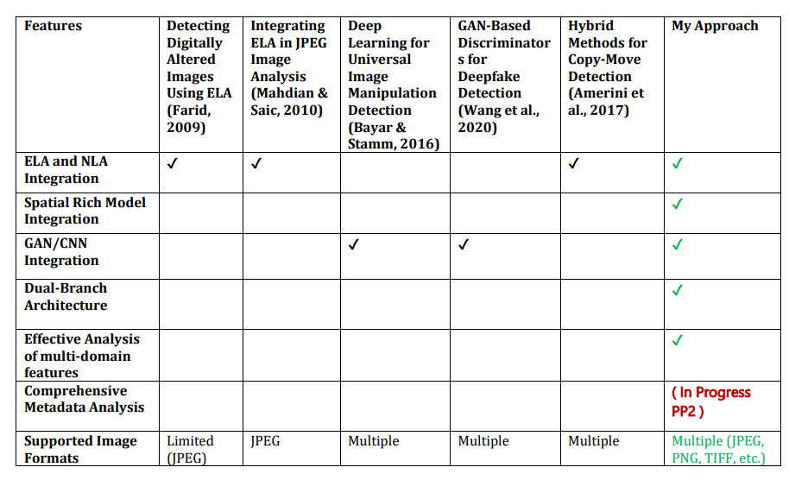

Research Gap
IT21299902 | ZAKEY M.S.M.A | 24-25J-137

Slide 16
METHODOLOGY
02
IT21299902 | ZAKEY M.S.M.A | 24-25J-137

Slide 17

Methodology cont.
Component development life cycle,
Data acquisition.
ELA and SRM filter functions development
Data set cleaning & Preprocessing the data.
Model development.
Model training and evaluation performance.
IT21299902 | ZAKEY M.S.M.A | 24-25J-137

Slide 18
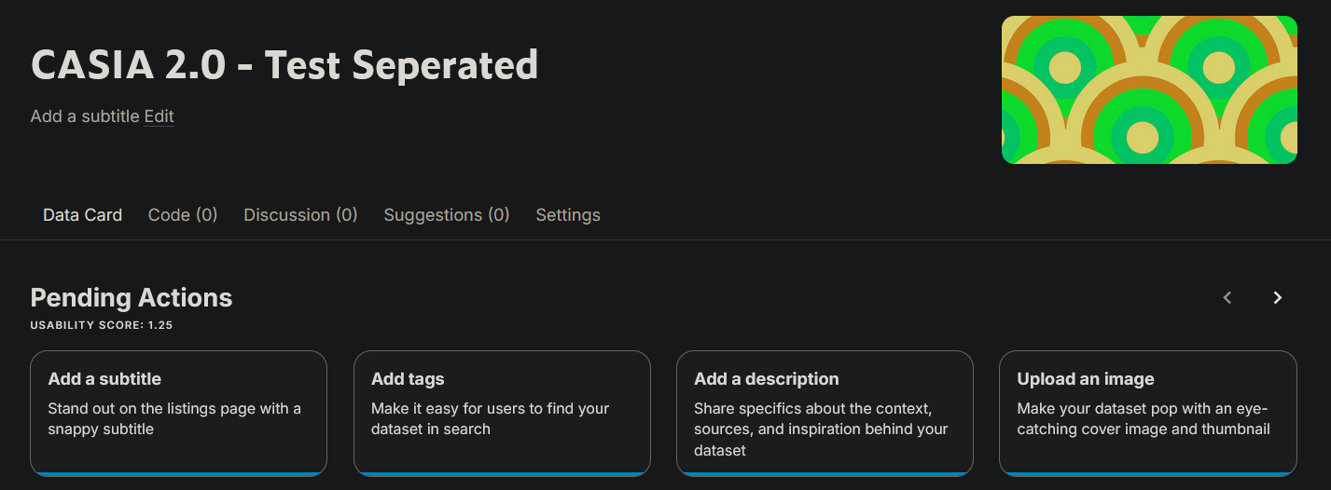
Methodology cont
Data Set
Link to Dataset - https://www.kaggle.com/datasets/asmathzakey/casia-2-0-test-seperated
IT21299902 | ZAKEY M.S.M.A | 24-25J-137

Slide 19
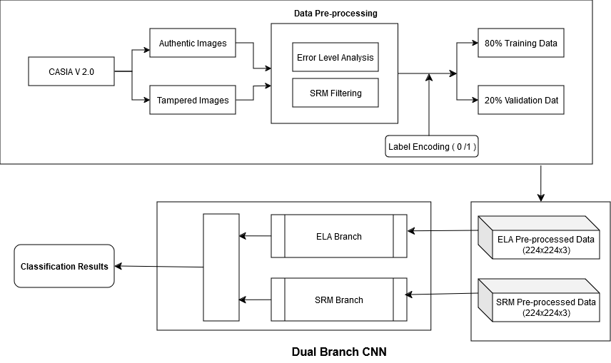
Methodology cont
Dula Branch Architecture - Detection framework with Deep learning models like Convolutional neural networks and incorporation of ELA +SRM filters.
IT21299902 | ZAKEY M.S.M.A | 24-25J-137

Slide 20
Evidences for the completion.
03
IT21299902 | ZAKEY M.S.M.A | 24-25J-137

Slide 21
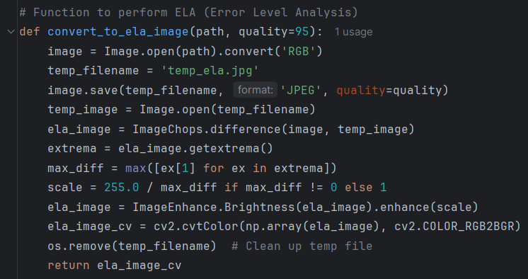
Error Level analysis
This function creates an Error Level Analysis (ELA) version of an input image to highlight areas that might have been tampered with.
Loading the Image
JPEG Compression
Computing Differences
Scaling for Visibility
Brightness Adjustment
Return the ELA image
IT21299902 | ZAKEY M.S.M.A | 24-25J-137

Slide 22

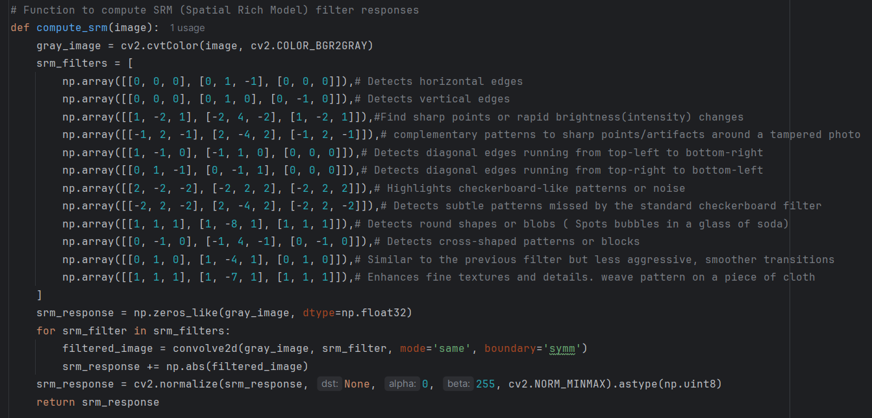
SRM filtering
This function performs Spatial Rich Model (SRM) filtering on an input image to highlight noise and artifacts, often used for tampering detection.
Grayscale Conversion
Defining SRM Filters -12
Applying Filters using 2D convolution
Normalization to a 0-255 range
Return the SRM response
IT21299902 | ZAKEY M.S.M.A | 24-25J-137

Slide 23
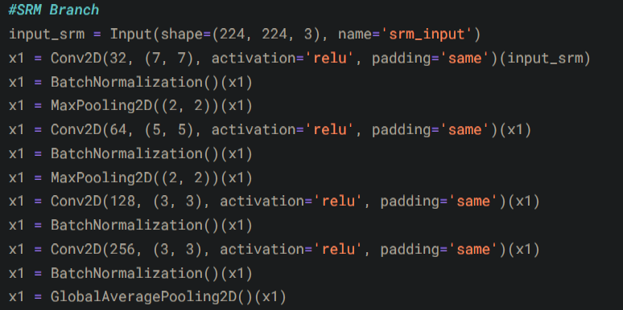
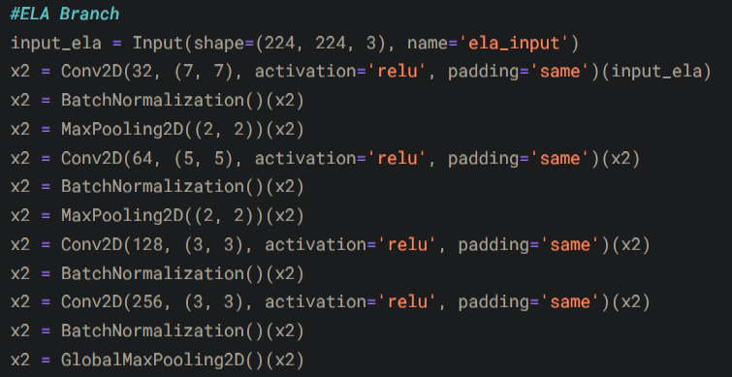
Dual Branch CNN
This Convolutional Neural Network (CNN) model designed to take two inputs SRM and ELA images.
The architecture is designed to extract features independently from each input type, then combine them for final classification.
First Input Branch (SRM Image) -12 layers
Second Input Branch (ELA Image) – 12 layers
Feature Concatenation and Classification – 6 layers
Model Compilation
Return Model
IT21299902 | ZAKEY M.S.M.A | 24-25J-137

Slide 24
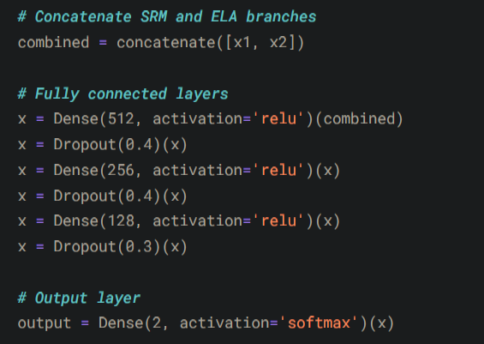
Dual Branch CNN
Feature Concatenation and Classification – 6 layers
IT21299902 | ZAKEY M.S.M.A | 24-25J-137

Slide 25
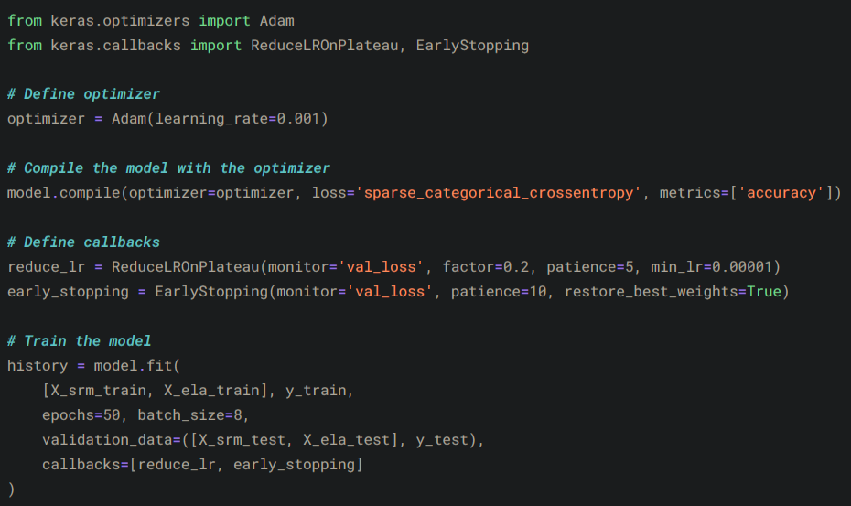
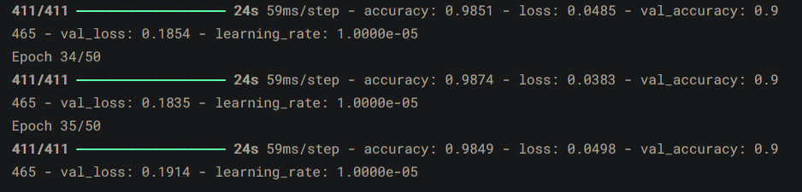
Dual Branch CNN - Training
ReduceLROnPlateau: Adjusts the learning rate if validation loss plateaus.
EarlyStopping: Stops training early if validation loss doesn’t improve, restoring the best weights
IT21299902 | ZAKEY M.S.M.A | 24-25J-137

Slide 26
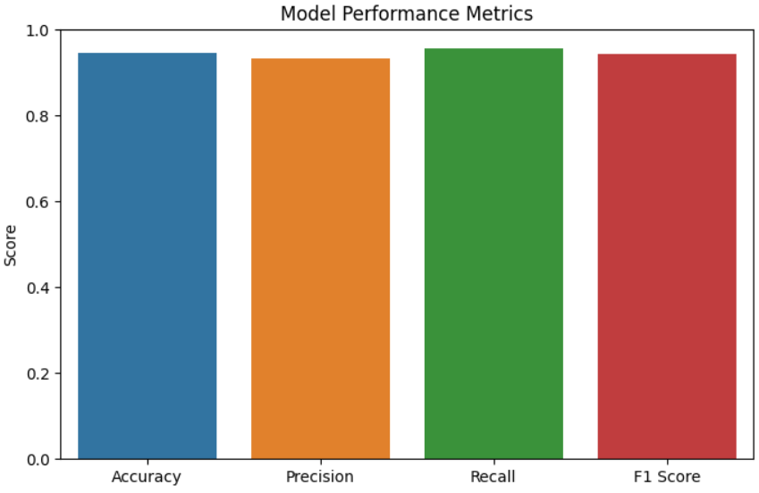
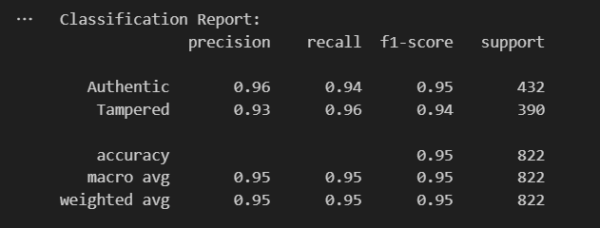
Model performance evaluation
Evaluate the trained model's performance on the test dataset, providing metrics for loss and accuracy.
Test loss 0.1519
Test Accuracy 0.9465 ( 95 %)
IT21299902 | ZAKEY M.S.M.A | 24-25J-137

Slide 27
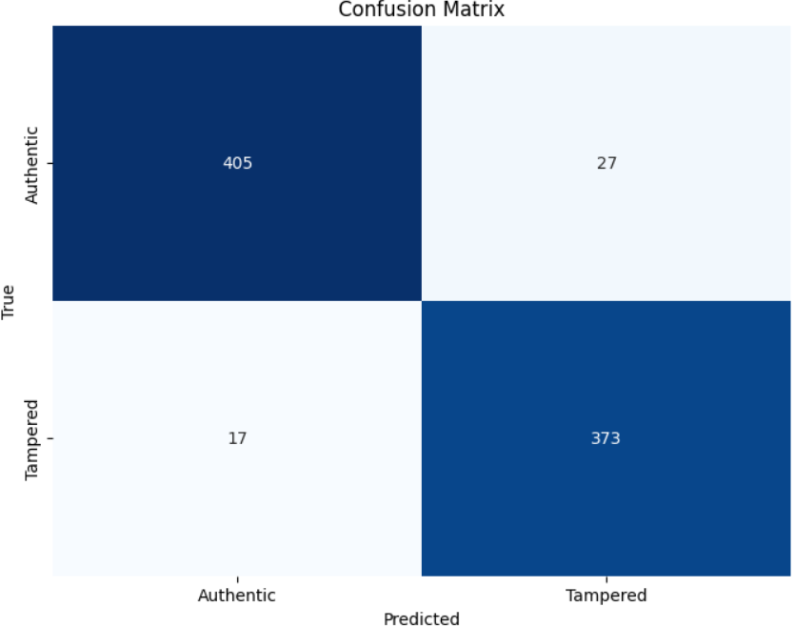
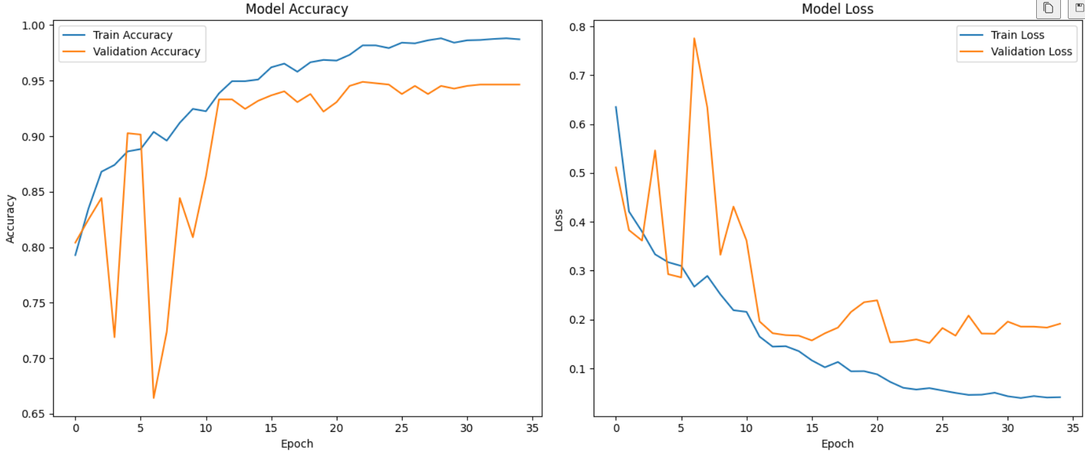
Model performance evaluation
Evaluate the trained model's performance on the test dataset, providing metrics for loss and accuracy.
IT21299902 | ZAKEY M.S.M.A | 24-25J-137

Slide 28
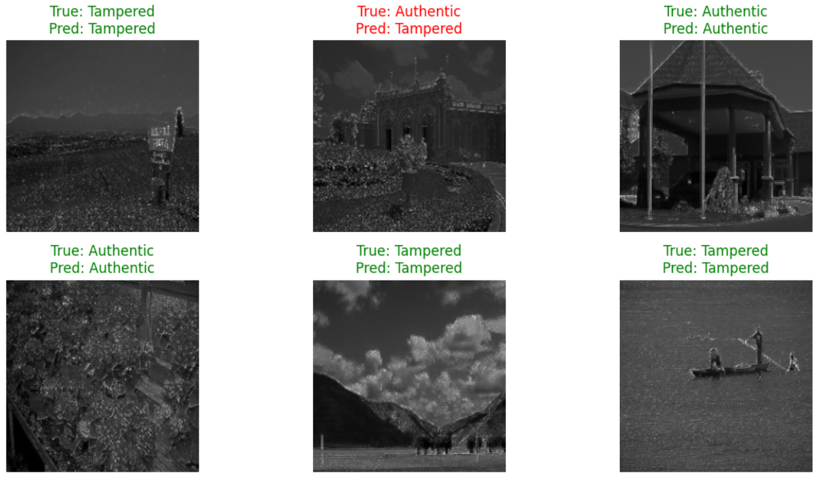
Model Output testing.
which visualizes a random selection of sample predictions from the test dataset, comparing true labels with predicted labels.
IT21299902 | ZAKEY M.S.M.A | 24-25J-137

Slide 29

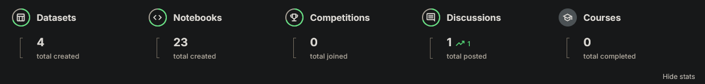
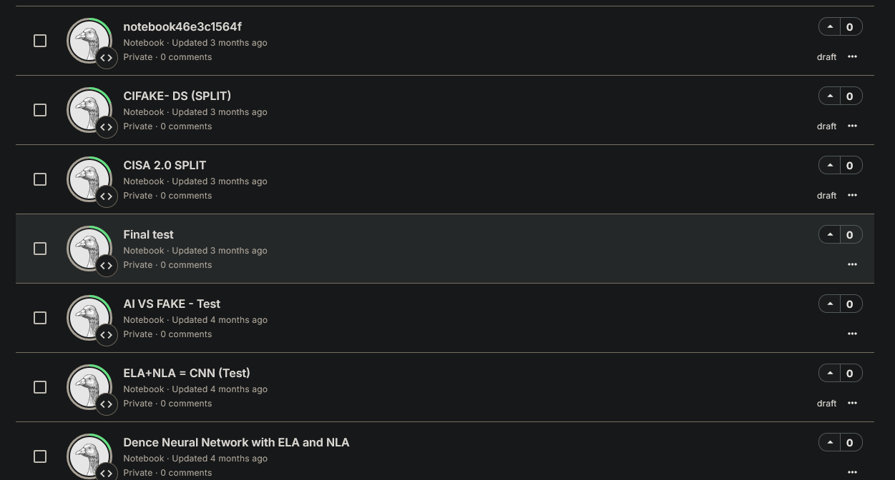
Try & Fails.
22 different try's 1 success.
IT21299902 | ZAKEY M.S.M.A | 24-25J-137

Slide 30

What's the next step.
In progress presentation 02.
Metadata Analysis for images.
Model confidence function.
Model Hyperparameter tuning – if needed
Implement UI
Implement security controls.
DB integration.
IT21299902 | ZAKEY M.S.M.A | 24-25J-137

Slide 31
REFERENCES
04
IT21299902 | ZAKEY M.S.M.A | 24-25J-137

Slide 32
REFERENCES cont
1. Farid, H. (2009). Techniques for detecting digitally altered images. Journal of Computational and Graphical Statistics.
2. Mahdian, B., & Saic, S. (2010). A bibliography on blind methods for identifying image forgery. Signal Processing: Image Communication.
3. Bayar, B., & Stamm, M. C. (2016). A deep learning approach to universal image manipulation detection using a new convolutional layer. Proceedings of the 4th ACM Workshop on Information Hiding and Multimedia Security.
4. Wang, S., Wang, Y., & Hwang, J. (2020). Detecting Deepfakes with GAN-based Discriminators. IEEE Transactions on Pattern Analysis and Machine Intelligence.
5. Amerini, I., Ballan, L., Caldelli, R., Del Bimbo, A., & Serra, G. (2017). A SIFT-based forensic method for copy-move attack detection and transformation recovery. IEEE Transactions on Information Forensics and Security
IT21299902 | ZAKEY M.S.M.A | 24-25J-137

Slide 33
IT21305078 | Dissanayake w. p. d. b.
BSc (Hons) in Information Technology Specializing in Cybersecurity
IT21305078 | Dissanayake W. P. D. B. | 24-25j-137

Slide 34
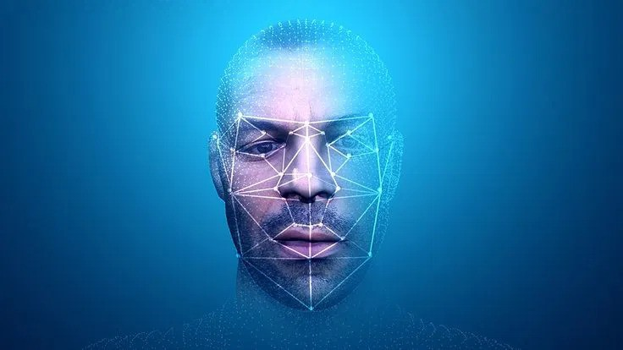
Deepfake Video ..Detection
IT21305078 | Dissanayake W. P. D. B. | 24-25j-137

Slide 35
Objective
Design a strong, efficient deepfake video detection framework using the hybrid neural network architectures that could effectively capture spatial inconsistencies using CNN and temporal anomalies using ConvLSTM in video sequences.
IT21305078 | Dissanayake W. P. D. B. | 24-25j-137

Slide 36

Commercialization
Market Opportunity
Growing concern over misinformation and digital media integrity.
Increasing demand from industries such as media, law enforcement, and cybersecurity.
Target Audience
Legal and forensic experts.
News organizations.
Social media platforms.
Corporate security teams.
IT21305078 | Dissanayake W. P. D. B. | 24-25j-137

Slide 37
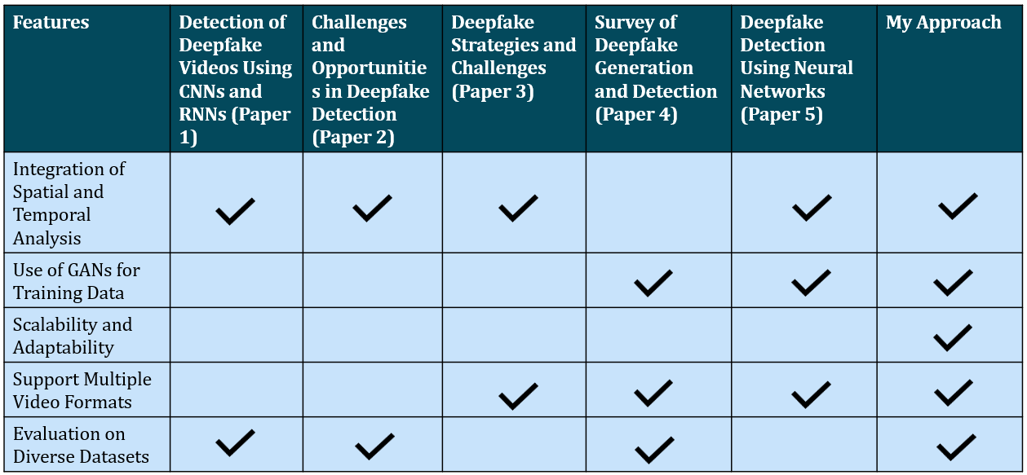
Proposed Research Gap
Already Done
To Be Done
Already Done
Already Done
Already Done
IT21305078 | Dissanayake W. P. D. B. | 24-25j-137

Slide 38
Component development life cycle
Requirement Analysis: Identify datasets(Celeb-DF-v2), features, and architecture needs.
Data Preprocessing: Extract frames, Resize, normalize pixel values, and Apply augmentation.
Feature Engineering: Extract spatial features using a CNN and Encode temporal relationships
using ConvLSTM.
Model Design: Build a hybrid architecture with CNN for spatial feature extraction and
ConvLSTM and Multi-Head Attention for spatiotemporal analysis.
System Integration: Combine preprocessing, feature extraction, and prediction modules.
Training & Validation: Train the model with class balancing, reduced learning rates, and
adaptive optimizers. Validate performance.
Evaluation: Test for accuracy and robustness on real-world reliability.
IT21305078 | Dissanayake W. P. D. B. | 24-25j-137

Slide 39
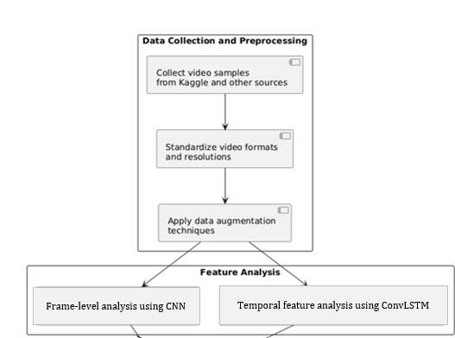
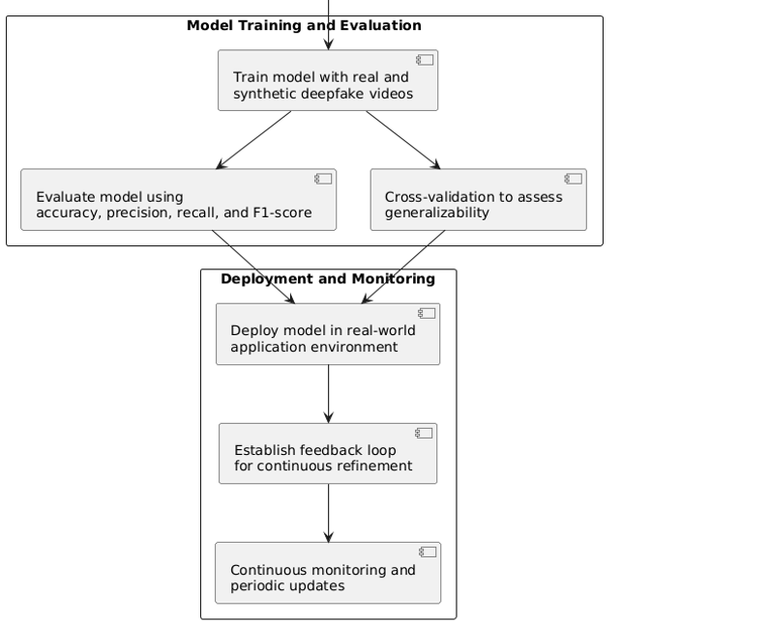
System Diagram
IT21305078 | Shehara M. G. D| 24-25j-137

Slide 40
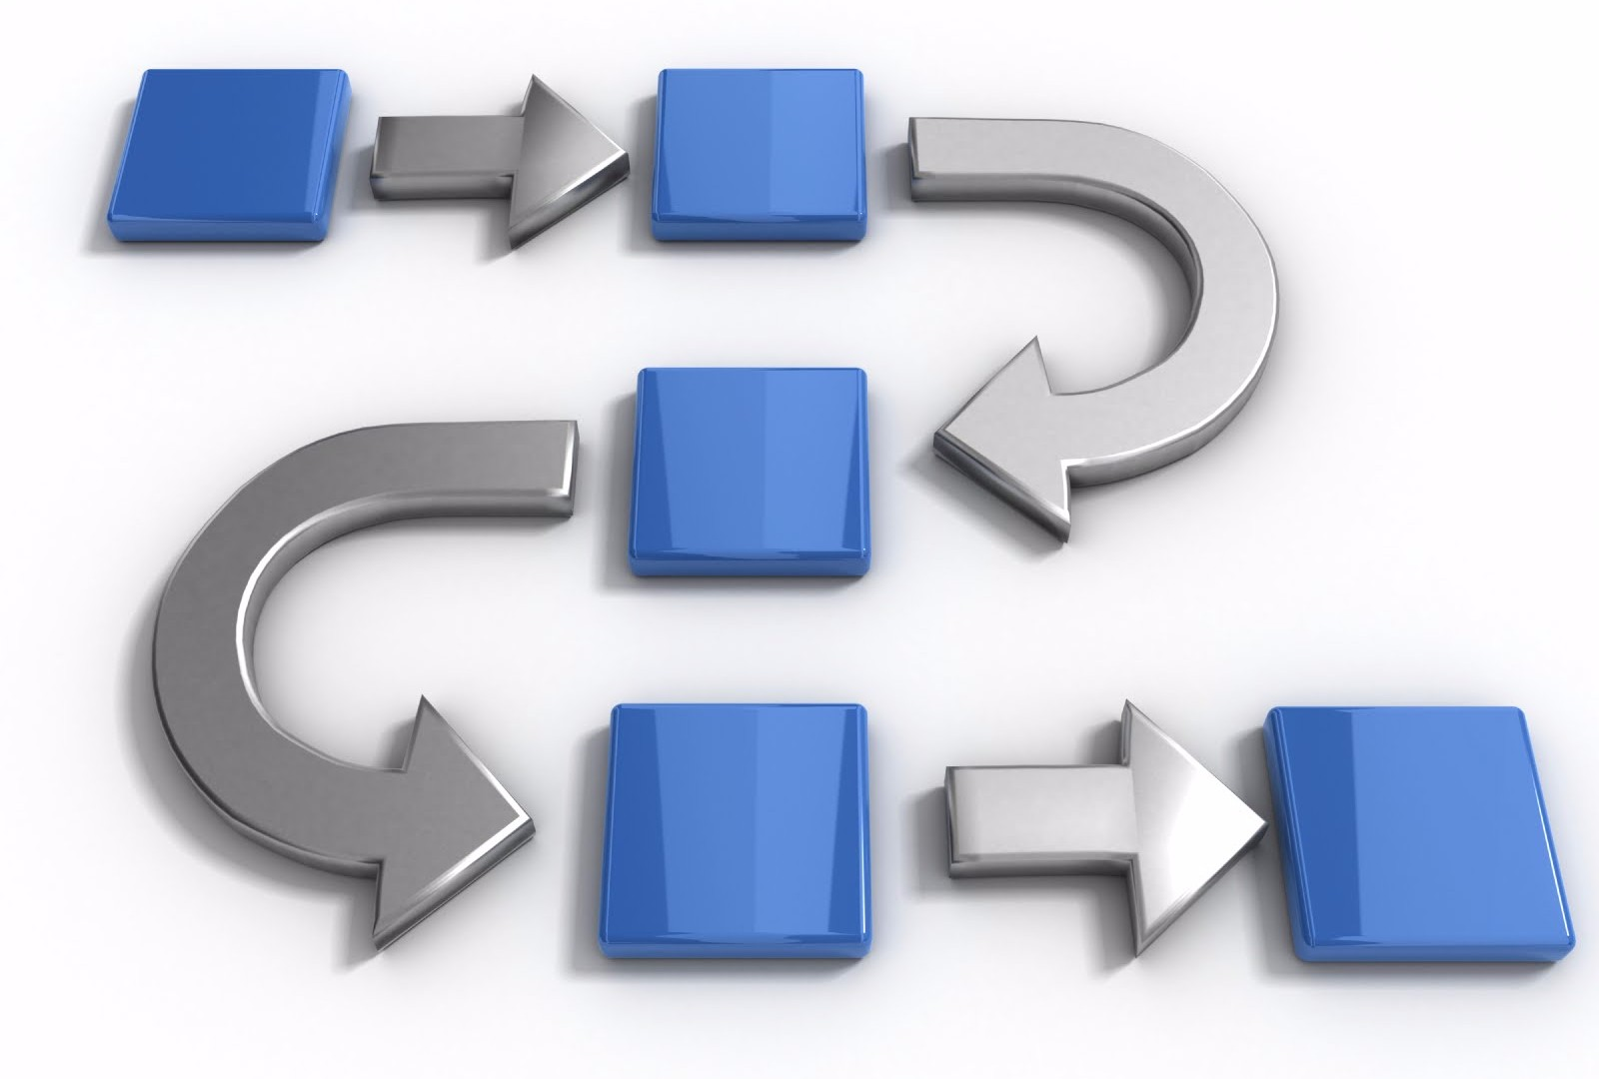
Methodology
IT21305078 | Dissanayake W. P. D. B. | 24-25j-137

Slide 41
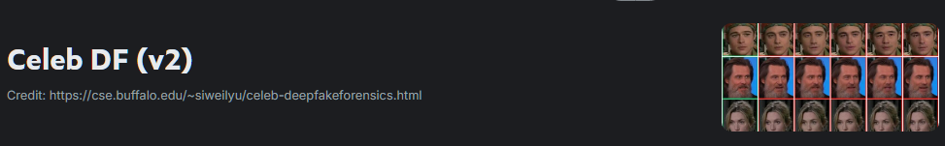
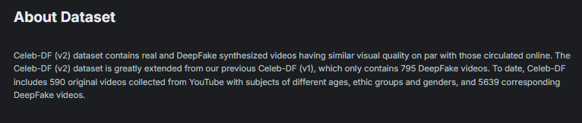
Dataset Selection
Dataset - https://www.kaggle.com/datasets/reubensuju/celeb-df-v2
IT21305078 | Dissanayake W. P. D. B. | 24-25j-137

Slide 42
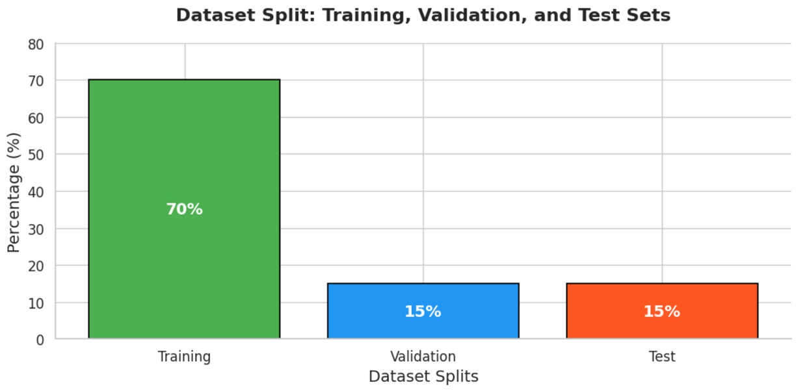
Data Distribution
80%
5%
IT21305078 | Dissanayake W. P. D. B. | 24-25j-137

Slide 43
Pipeline Overview
Dataset Preparation : Organized and split videos into training, validation, and testing sets.
Preprocessing and Augmentation : Extracted and augmented frames for robust training.
Feature Extraction : Encoded spatial features from frames using a CNN.
Model Training : Trained a ConvLSTM model for video classification.
Show in the DEMO…
IT21305078 | Dissanayake W. P. D. B. | 24-25j-137

Slide 44
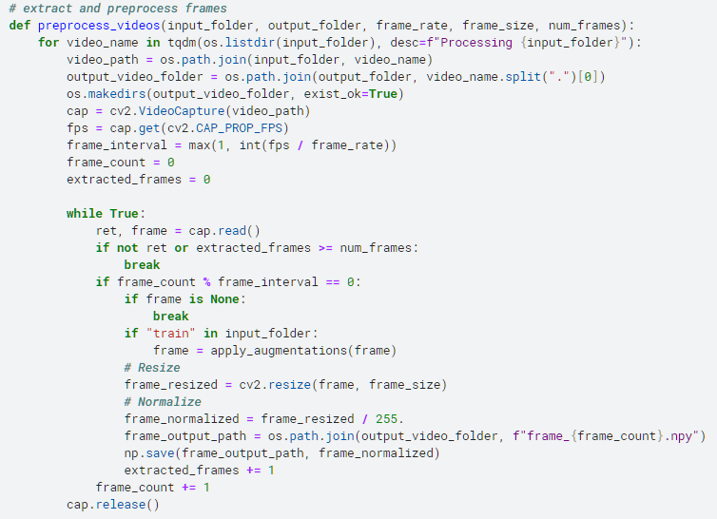
Pipeline Explained - Preprocessing
IT21305078 | Dissanayake W. P. D. B. | 24-25j-137

Slide 45
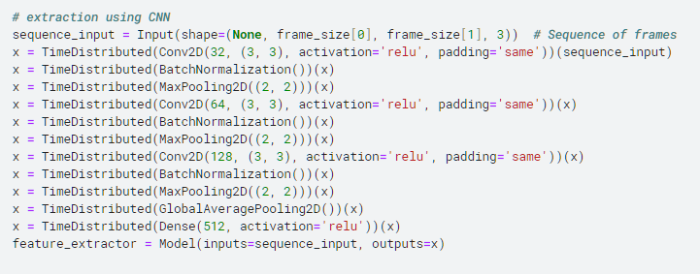
Pipeline Explained - Feature Extraction
Conv2D: For spatial feature extraction
BatchNormalization: To stabilize training and improve convergence
MaxPooling2D: For down-sampling spatial dimensions
GlobalAveragePooling2D: For dimensionality reduction
Dense: To project features into a 512-dimensional space.
IT21305078 | Dissanayake W. P. D. B. | 24-25j-137

Slide 46
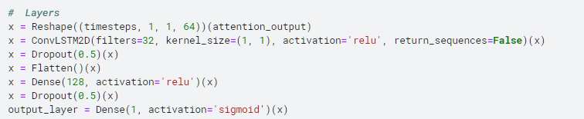
Pipeline Explained - Training the ConvLSTM Model
ConvLSTM Layer 1: Captures spatiotemporal dependencies.
Attention Mechanism: Highlights important temporal patterns.
ConvLSTM Layer 2: Further processes sequences.
Dense Layers: Refines features for classification
IT21305078 | Dissanayake W. P. D. B. | 24-25j-137

Slide 47
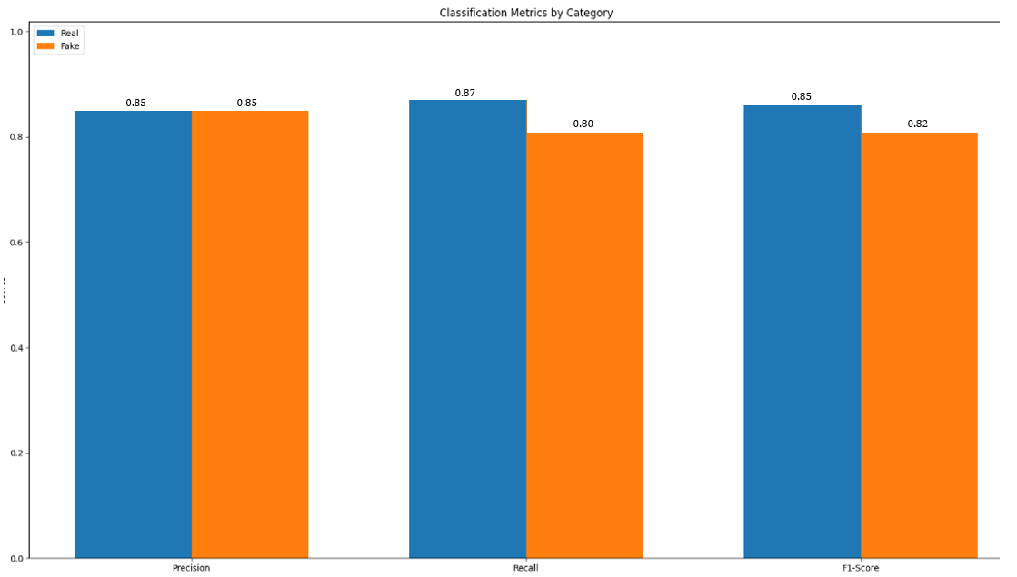
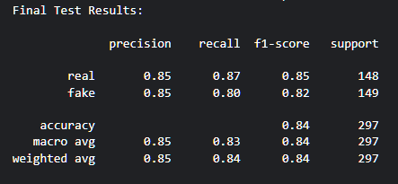
Model Evaluation Results On Unseen Test Data
Test Accuracy: 0.85 (= 85%)
IT21305078 | Dissanayake W. P. D. B. | 24-25j-137

Slide 48
In Next Step…
Model Performance Improvements (e.g. Optimize the hybrid Model).
Model Drift Detection and Automated Retraining Pipelines.
User Interface (UI) Design and Implementation.
Security Controls and Robustness Against Attacks.
Database Integration for Data and Model Management.
IT21305078 | Dissanayake W. P. D. B. | 24-25j-137

Slide 49
References
[1] R. Mubarak, T. Alsbou’i, O. Alshaikh, I. Inuwa-Dute, S. Khan, and S. Parkinson, “A Survey on the Detection and Impacts of Deepfakes in Visual, Audio, and Textual Formats,” IEEE Access, vol. PP, p. 1, Jan. 2023, doi: 10.1109/ACCESS.2023.3344653.
[2] Z. Xia, T. Qiao, M. Xu, N. Zheng, and S. Xie, “Towards DeepFake video forensics based on facial textural disparities in multi-color channels,” Inf. Sci. (Ny)., vol. 607, pp. 654–669, 2022, doi: https://doi.org/10.1016/j.ins.2022.06.003.
[3] S. Al-khazraji, H. Saleh, A. KHALID, and I. Mishkhal, “Impact of Deepfake Technology on Social Media: Detection, Misinformation and Societal Implications,” Eurasia Proc. Sci. Technol. Eng. Math., vol. 23, pp. 429–441, Oct. 2023, doi: 10.55549/epstem.1371792.
[4] M. Habeb, L. Elrefaei, and M. Salama, “Enhancing Video Anomaly Detection Using a Transformer Spatiotemporal Attention Unsupervised Framework for Large Datasets,” Algorithms, vol. 17, Jul. 2024, doi: 10.3390/a17070286.
[5] E. M. Saoudi, J. Jaafari, and S. J. Andaloussi, “Advancing human action recognition: A hybrid approach using attention-based LSTM and 3D CNN,” Sci. African, vol. 21, p. e01796, 2023, doi: https://doi.org/10.1016/j.sciaf.2023.e01796.
IT21305078 | Dissanayake W. P. D. B. | 24-25j-137

Slide 50

IT21305078 | Shehara M. G. D
BSc (Hons) in Information Technology Specialising in Cybersecurity
IT21305078 | Shehara M. G. D| 24-25j-137

Slide 51
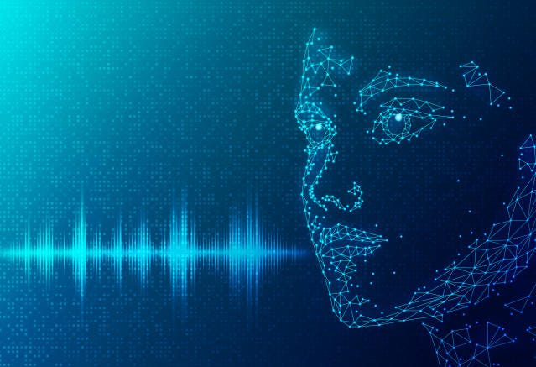
Deepfake Audio Detection
IT21305078 | Shehara M. G. D| 24-25j-137

Slide 52
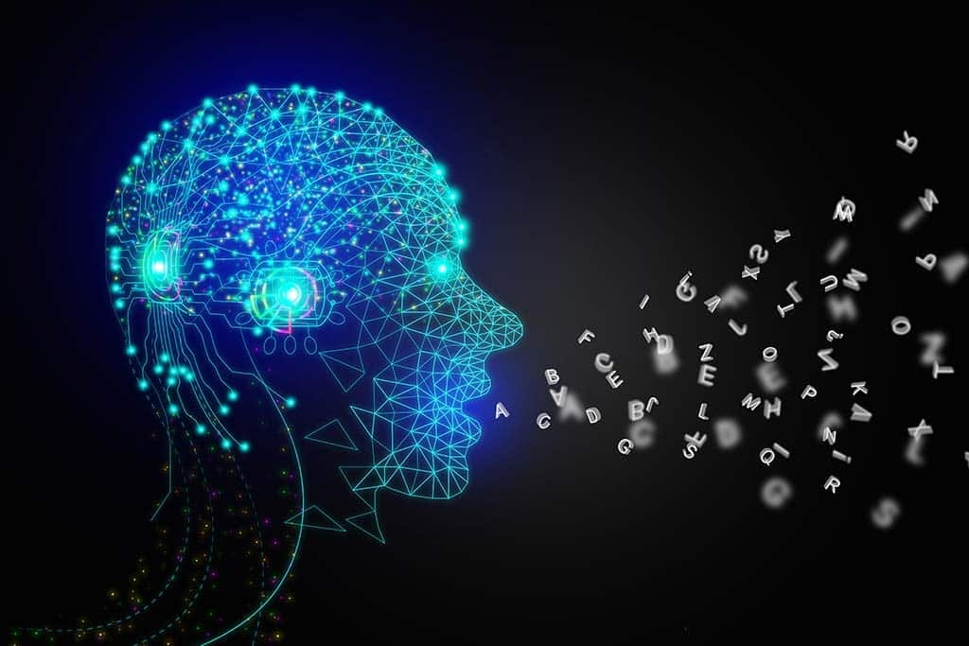
Objective
To develop a hybrid deep learning system for accurate multilingual deepfake audio detection by leveraging advanced preprocessing, multimodal feature extraction, and attention-driven neural architectures, integrating diverse spectral and temporal representations (Mel and CQT spectrograms) and numerical descriptors (MFCCs, ZCR, spectral centroid etc:) to ensure robust analysis of audio authenticity.
IT21305078 | Shehara M. G. D| 24-25j-137

Slide 53
Commercialization
Market Opportunity
Growing concern over misinformation and digital media integrity.
Increasing demand from industries such as media, law enforcement, and cybersecurity.
Target Audience
Legal and forensic experts.
News organizations.
Social media platforms.
Corporate security teams.
IT21305078 | Shehara M. G. D| 24-25j-137

Slide 54
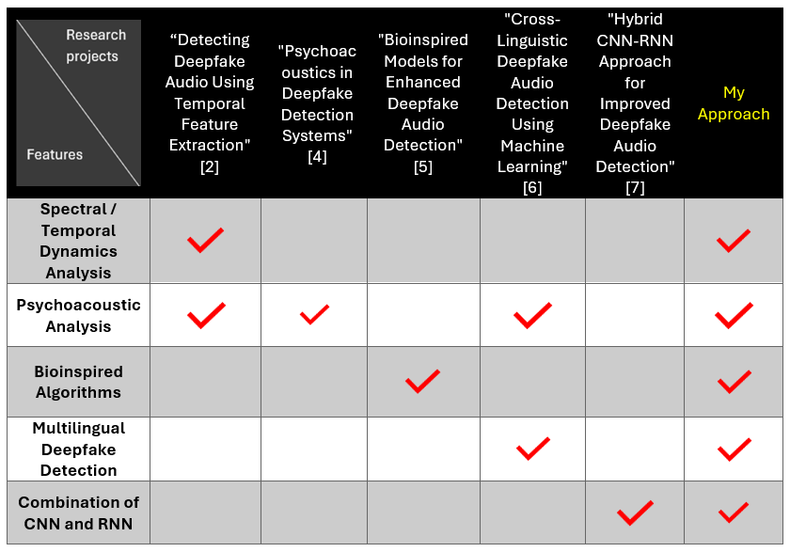
Proposed Research Gap
Already Done
Already Done
Already Done
To Be Done
Already Done
IT21305078 | Shehara M. G. D| 24-25j-137

Slide 55
Component development life cycle
Requirement Analysis: Identify datasets, features, and architecture needs.
Data Preprocessing: Clean, normalize, and prepare audio files.
Feature Engineering: Extract meaningful audio features like spectrograms and MFCCs.
Model Design: Build a multi-input deep learning model for real vs. fake classification.
System Integration: Combine preprocessing, feature extraction, and prediction modules.
Training & Validation: Train and fine-tune the model with callbacks for optimal performance.
Evaluation: Test for accuracy, robustness, and real-world reliability.
IT21305078 | Shehara M. G. D| 24-25j-137

Slide 56
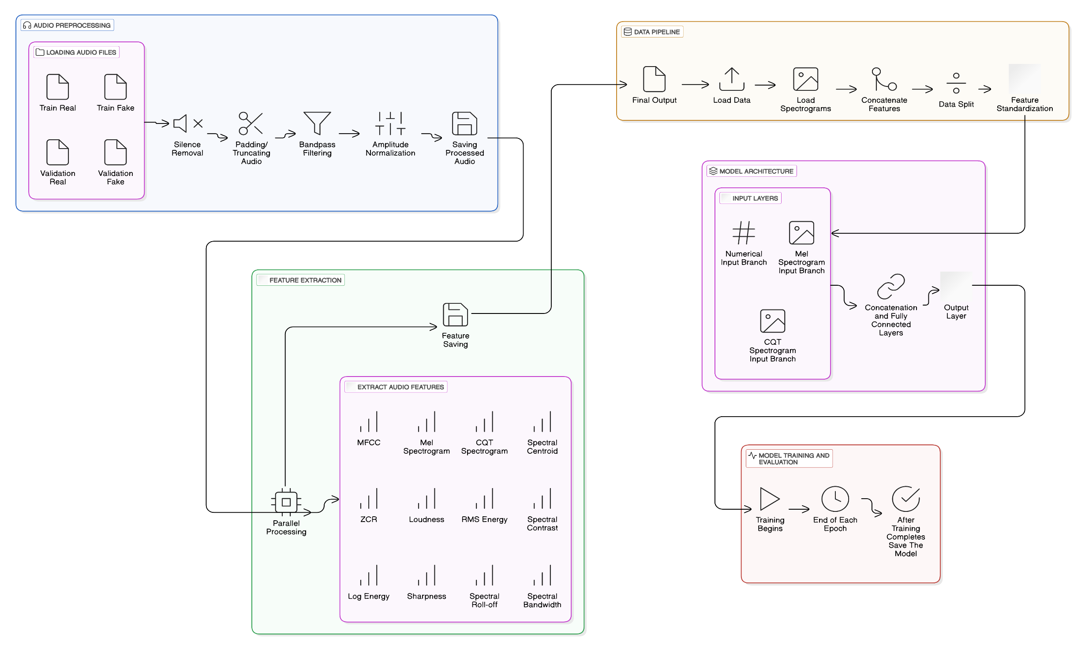
System Diagram
IT21305078 | Shehara M. G. D| 24-25j-137

Slide 57
Methodology
IT21305078 | Shehara M. G. D| 24-25j-137

Slide 58

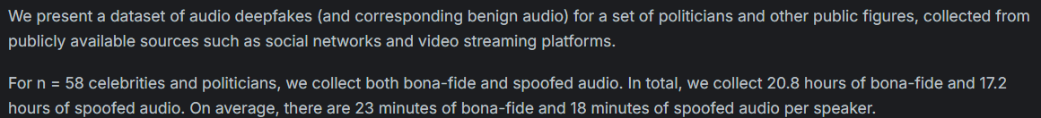
Dataset Selection
Dataset - https://www.kaggle.com/datasets/abdallamohamed312/in-the-wild-dataset
IT21305078 | Shehara M. G. D| 24-25j-137

Slide 59
Data Distribution
IT21305078 | Shehara M. G. D| 24-25j-137

Slide 60
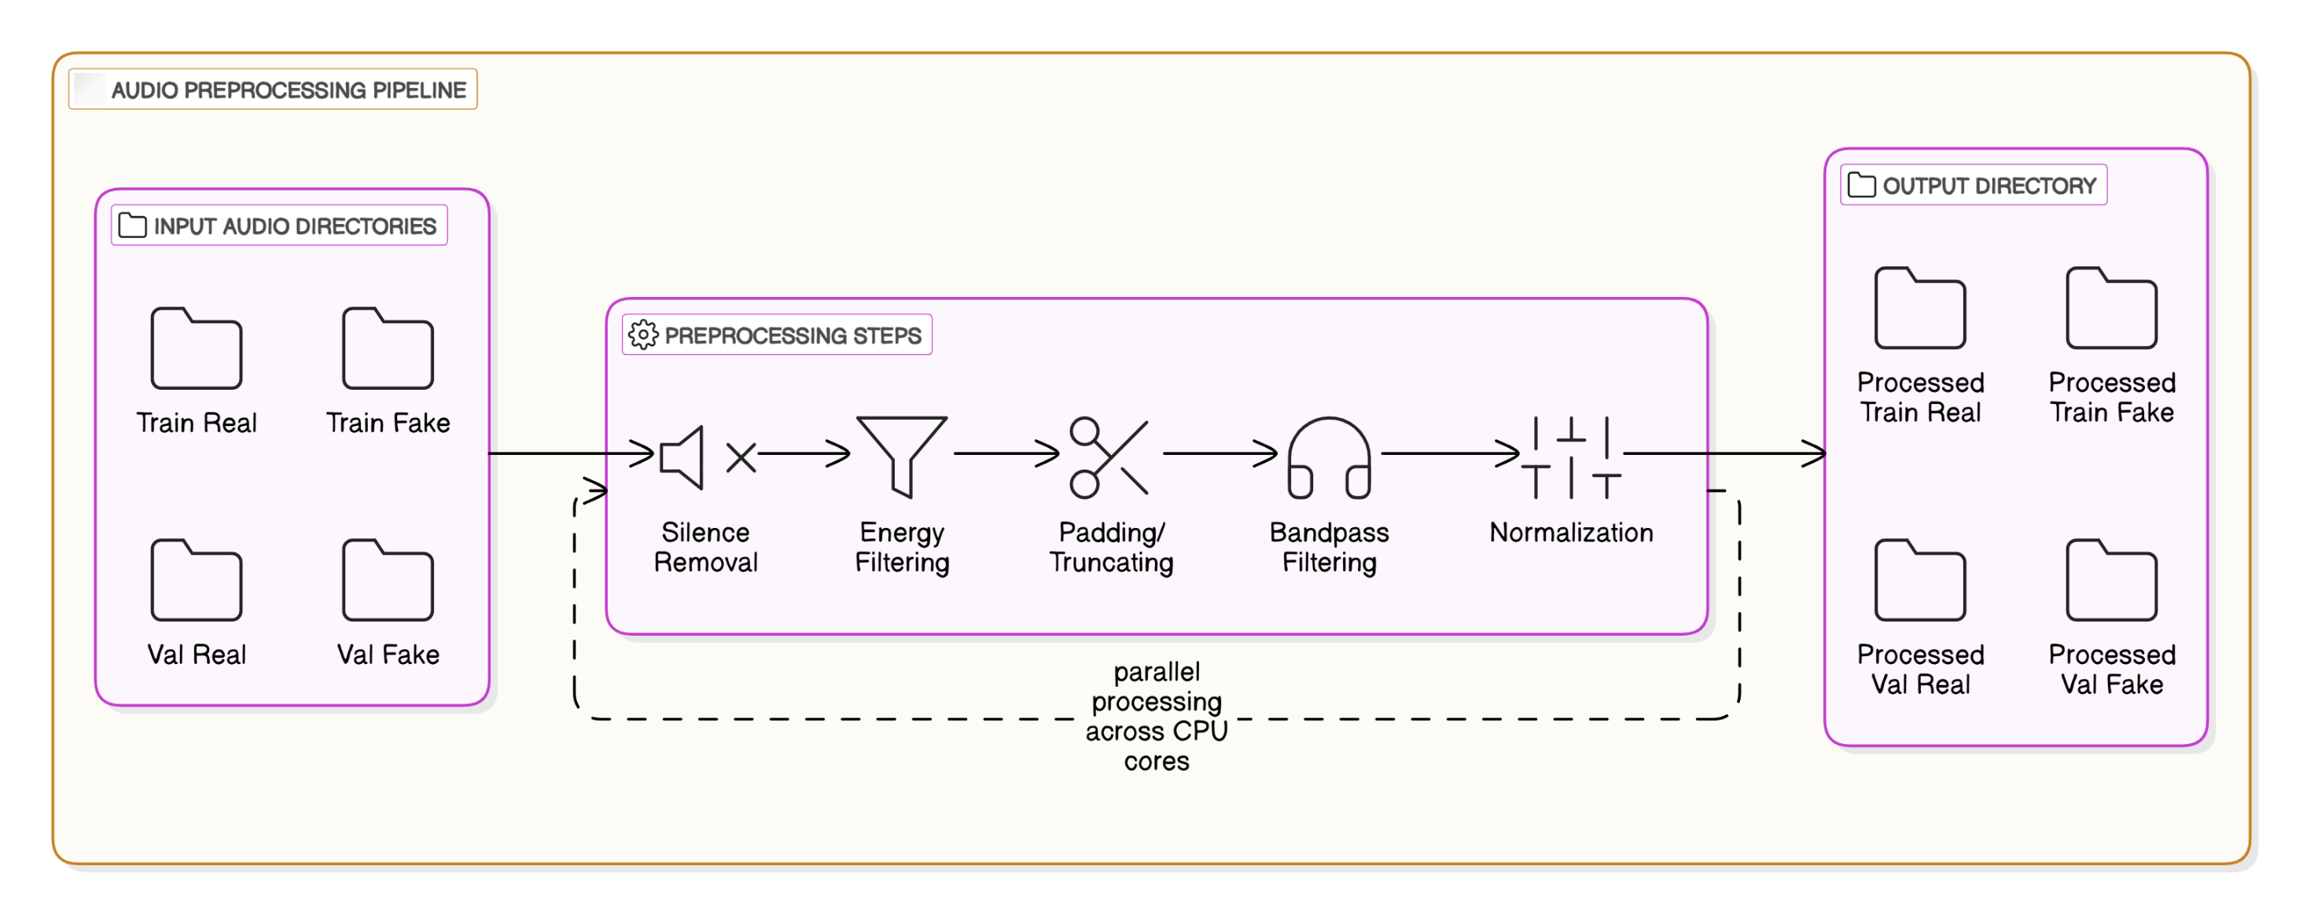
Raw Audio Preparation
IT21305078 | Shehara M. G. D| 24-25j-137

Slide 61
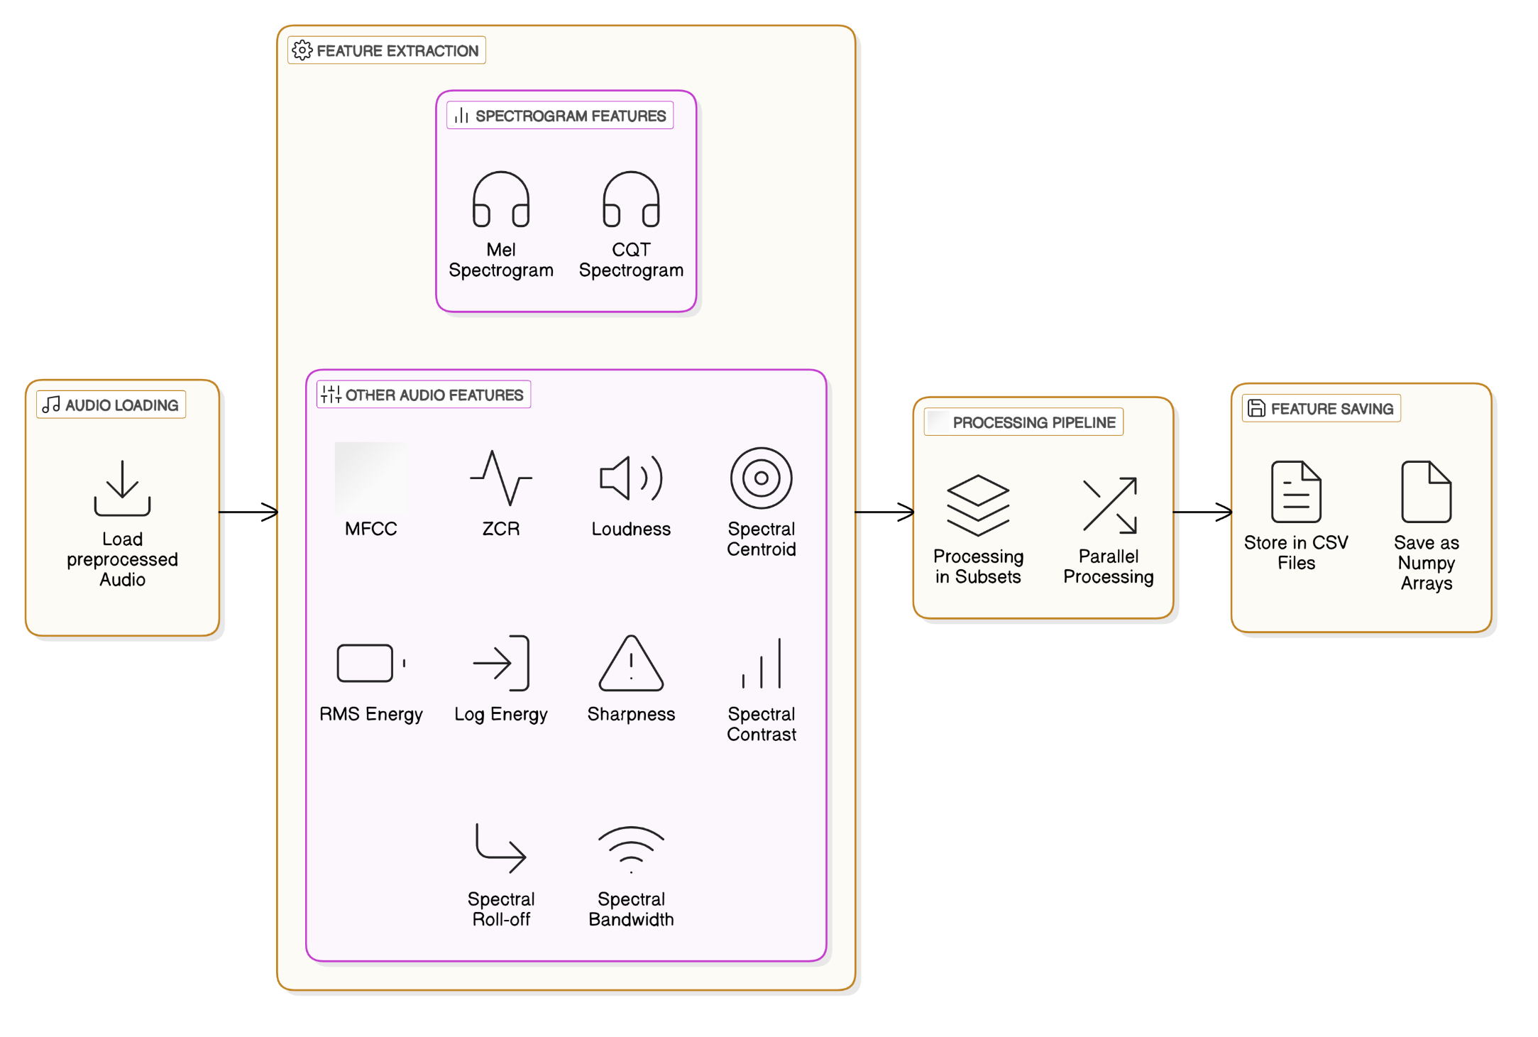
Audio Features Extraction
IT21305078 | Shehara M. G. D| 24-25j-137

Slide 62
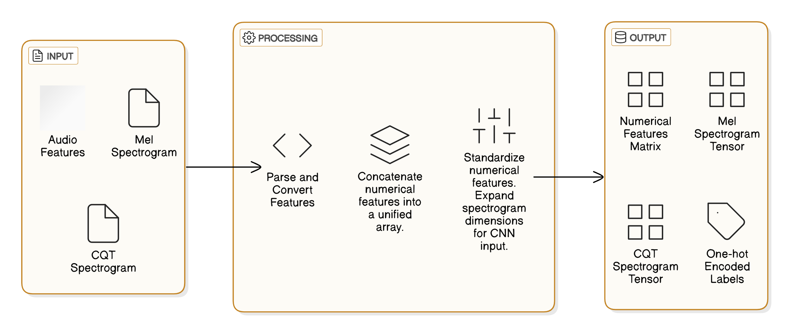
Extracted Features Preparation
IT21305078 | Shehara M. G. D| 24-25j-137

Slide 63
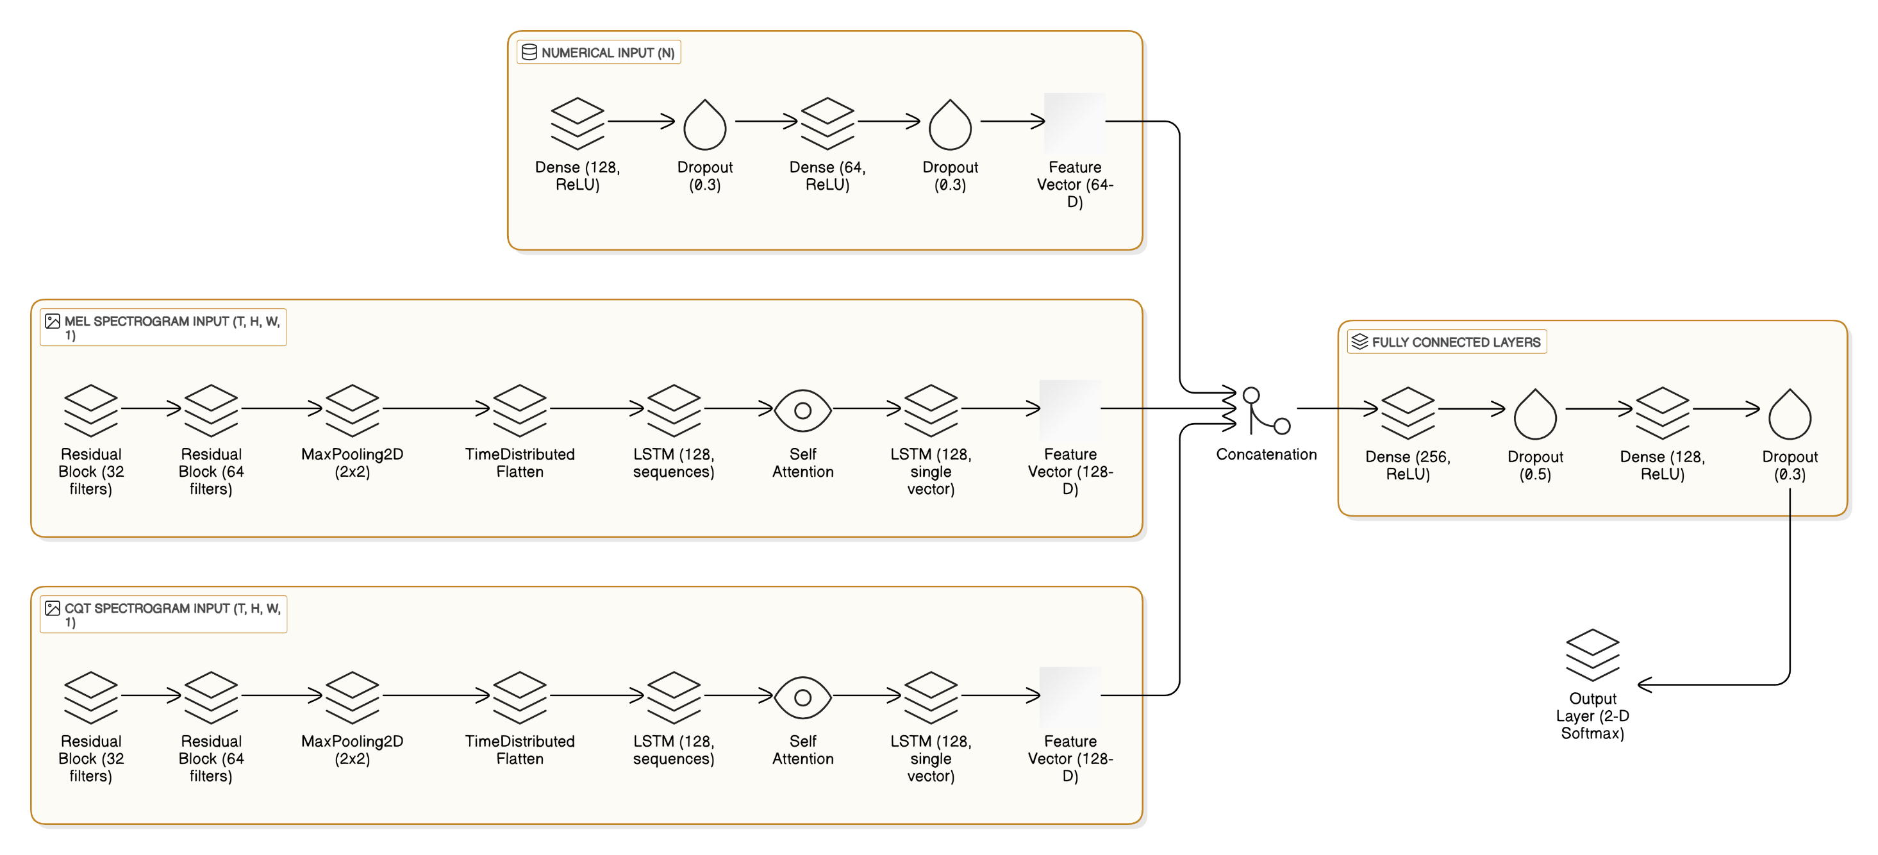
Hybrid (ResNet[CNN]-LSTM-AttentionNet) Model Architecture
IT21305078 | Shehara M. G. D| 24-25j-137

Slide 64
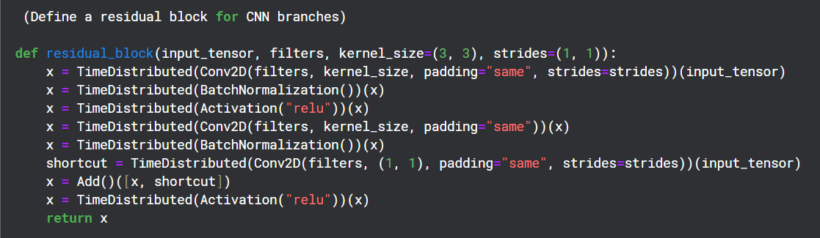
Hybrid (ResNet[CNN]-LSTM-AttentionNet) Model Architecture
1. First Convolutional Layer: Extracts spatial features (patterns like edges, textures) from the input tensor using a convolutional operation.
2. Batch Normalization: Normalizes the activations for each batch, improving training stability and convergence.
3. Activation: Introduces non-linearity, allowing the network to learn complex functions.
4. Second Convolutional Layer: Further processes the features extracted by the first convolutional layer, capturing more complex patterns.
5. Batch Normalization (again): Normalizes the activations after the second convolution to maintain training stability.
6. Shortcut Path: A direct connection bypassing the convolutional layers, allowing the network to retain original input features.
7. Add Shortcut to Main Path and 8. Final Activation Introduces non-linearity to the combined output.
IT21305078 | Shehara M. G. D| 24-25j-137

Slide 65
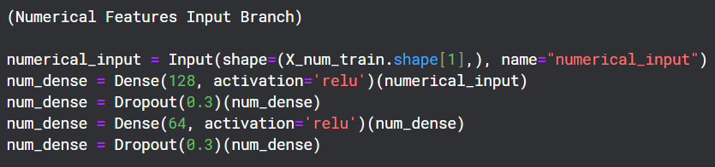
Hybrid (ResNet[CNN]-LSTM-AttentionNet) Model Architecture
Input Layer (numerical_input)
Purpose: Accepts the numerical features that extracted from the audio.
Dense Layers
Dense(128, activation='relu'): Fully connected layer that learns relationships between numerical features. Produces a 128-dimensional representation.
Dropout(0.3): Drops out 30% of the neurons to prevent overfitting.
Dense(64, activation='relu'): Reduces the dimensionality while learning abstract features.
Dropout(0.3): Adds additional regularization.
IT21305078 | Shehara M. G. D| 24-25j-137

Slide 66
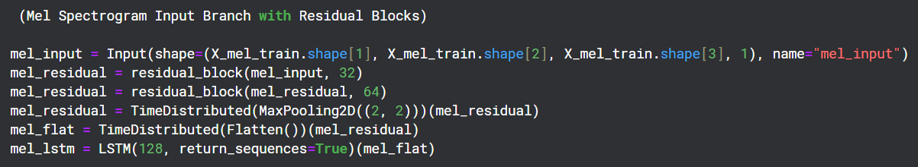
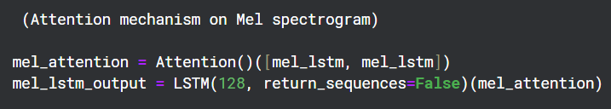
Hybrid (ResNet[CNN]-LSTM-AttentionNet) Model Architecture
1. Input Layer (mel_input)
Purpose: Accepts the Mel spectrogram input, which encodes the time-frequency representation of the audio.
2. Residual Blocks
Purpose: Capture complex features with skip connections to preserve information.
Inside each block:
Conv2D + BatchNormalization + ReLU: Detects local patterns in the spectrogram, normalizes the activations for stability, and applies the ReLU activation function.
Shortcut Connection (Conv2D): Aligns dimensions of the input and output, ensuring that the residual connection works.
Add + ReLU: Combines the input (shortcut) with the processed features and applies a ReLU to introduce non-linearity.
IT21305078 | Shehara M. G. D| 24-25j-137

Slide 67
Hybrid (ResNet[CNN]-LSTM-AttentionNet) Model Architecture
3. TimeDistributed(MaxPooling2D)
Purpose: Reduces the spatial resolution of the feature maps, keeping the most salient features.
4. TimeDistributed(Flatten)
Purpose: Flattens the 2D spatial representation into a 1D vector while preserving the temporal structure.
5. LSTM(128, return_sequences=True)
Purpose: Processes the temporal sequences of flattened feature vectors, learning sequential patterns in the Mel spectrogram.
6. Attention Mechanism
Purpose: Highlights the most important parts of the time series by weighting time steps dynamically.
Self-attention mechanism comparing each time step to others.
7. LSTM(128, return_sequences=False)
Purpose: Reduces the sequence to a single vector representation, summarizing the important temporal info.
IT21305078 | Shehara M. G. D| 24-25j-137

Slide 68
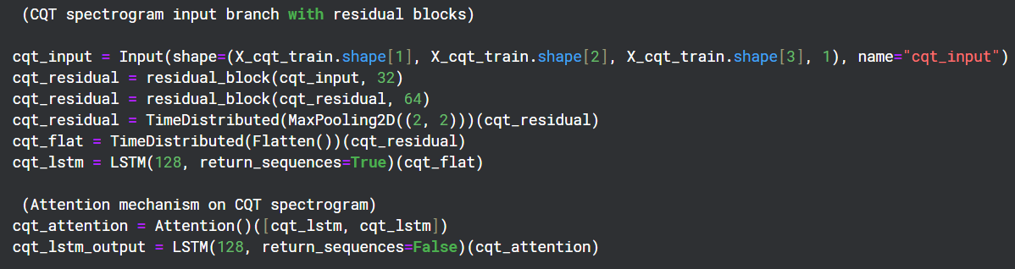
Hybrid (ResNet[CNN]-LSTM-AttentionNet) Model Architecture
This branch mirrors the Mel Spectrogram Branch but processes Constant-Q Transform (CQT) spectrograms.
IT21305078 | Shehara M. G. D| 24-25j-137

Slide 69
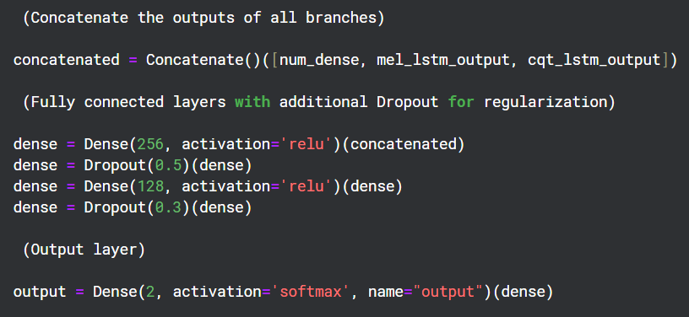
Hybrid (ResNet[CNN]-LSTM-AttentionNet) Model Architecture
1. Concatenate
Purpose: Combines the outputs of the numerical, Mel spectrogram, and CQT spectrogram branches into a single feature vector.
IT21305078 | Shehara M. G. D| 24-25j-137

Slide 70
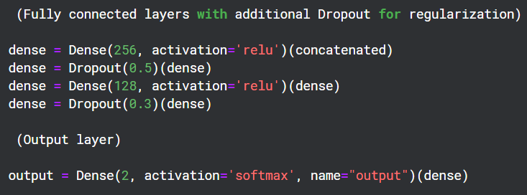
Hybrid (ResNet[CNN]-LSTM-AttentionNet) Model Architecture
2. Dense Layers
Dense(256, activation='relu'): A fully connected layer that learns combined representations from the three branches.
Dropout(0.5): Regularizes the model by randomly deactivating neurons.
Dense(128, activation='relu'): Refines the combined features further.
Dropout(0.3): Adds additional regularization.
3. Output Layer
Purpose: Produces probabilities for two classes: real audio and fake audio. The softmax activation ensures the output sums to 1.
IT21305078 | Shehara M. G. D| 24-25j-137

Slide 71

Hybrid (ResNet[CNN]-LSTM-AttentionNet) Model Architecture
The Adam optimizer with a small learning rate ensures that the model learns efficiently and avoids overshooting the optimal weights.
The categorical crossentropy loss guides the model to assign probabilities to the correct class (real vs. fake audio).
The accuracy metric allows to monitor how often the model’s predictions match the true labels, giving a quick indication of its classification performance during training and validation.
IT21305078 | Shehara M. G. D| 24-25j-137

Slide 72

Model Training
IT21305078 | Shehara M. G. D| 24-25j-137

Slide 73


Model Evaluation Results On Unseen Test Data
Test Loss: 0.11685
Test Accuracy: 0.958273 (~ 96%)
IT21305078 | Shehara M. G. D| 24-25j-137

Slide 74

Model Evaluation Results On Unseen Test Data
IT21305078 | Shehara M. G. D| 24-25j-137

Slide 75

Model Evaluation Results On Unseen Test Data
True Positives: 1588
True Negatives: 1742
False Positives: 53
False Negatives: 92
IT21305078 | Shehara M. G. D| 24-25j-137

Slide 76

Unseen Audio Test – Actual Class Vs Predicted Class
The model achieved an impressive performance, correctly predicting 29 out of 30 instances, with only 1 incorrect prediction.
IT21305078 | Shehara M. G. D| 24-25j-137

Slide 77

In Next Step…
Multi-Language Deep Fake Audio Detection.
Model Performance Improvements (e.g. Optimization).
Explainable AI (XAI) for Model Interpretability.
Model Drift Detection and Automated Retraining Pipelines.
User Interface (UI) Design and Implementation.
Security Controls and Robustness Against Attacks.
Database Integration for Data and Model Management.
IT21305078 | Shehara M. G. D| 24-25j-137

Slide 78
References
[1] A. Qais, A. Rastogi, A. Saxena, A. Rana and D. Sinha, "Detecting Deepfake Audio Using Temporal Feature Extraction," 2022 International Conference on Intelligent Controller and Computing for Smart Power (ICICCSP), Hyderabad, India, 2022, pp. 1-6, doi: 10.1109/ICICCSP53532.2022.9862519. keywords: {Deepfakes;Recurrent neural networks;Feature extraction;Data models;Numerical models;Convolutional neural networks;Arrays;Convolutional neural network;Audio Processing;FFT;Fast Fourier Transform;MFCC: Mel Frequency Cepstral Coefficient;STFT: Short Time Fourier Transform;Spectrogram;Spoofing detection},
[2] L. Nguyen-Vu, T. -P. Doan, M. Bui, K. Hong and S. Jung, "Integrating Psychoacoustics in Deepfake Detection Systems," in IEEE Access, vol. 11, pp. 94563-94574, 2023, doi: 10.1109/ACCESS.2023.3310809.keywords: {Band-pass filters;Training;Psychoacoustic models;Perturbation methods;Robustness;Closed box;Spectrogram;Adversarial machine learning;Psychoacoustic models;Automatic speaker verification;adversarial attack;spoofing countermeasure;psychoacoustics},
[3] T. Cazalets and J. Dambre, "Bioinspired Models for Enhanced Deepfake Audio Detection," 2023 RIVF International Conference on Computing and Communication Technologies (RIVF), Hanoi, Vietnam, 2023, pp. 458-463, doi: 10.1109/RIVF60135.2023.10471845. keywords: {Heuristic algorithms;Biological system modeling;Time series analysis;Speech recognition;Computer architecture;Homeostasis;Reservoirs},
[4] Z. Khanjani, L. Davis, A. Tuz, K. Nwosu, C. Mallinson and V. P. Janeja, "Cross-Linguistic Deepfake Audio Detection Using Machine Learning," 2023 IEEE International Conference on Intelligence and Security Informatics (ISI), Charlotte, NC, USA, 2023, pp. 01-06, doi: 10.1109/ISI58743.2023.10297267. keywords: {Training;Annotations;Linguistics;Phonetics;Media;Feature extraction;Security;audio deepfake;spoofed audio detection;Artificial Intelligence;linguistics;sociolinguistics;linguistic perception},
[5] Al-Adwan, A.; Alazzam, H.; Al-Anbaki, N.; Alduweib, E. Hybrid CNN-RNN Approach for Improved Deepfake Audio Detection. Computers 2024, 13, 99. https://doi.org/10.3390/computers13040099
IT21305078 | Shehara M. G. D| 24-25j-137

Slide 79

IT21267086 | Hasara L. A. N
BSc (Hons) in Information Technology Specialising in Cyber Security
IT21267086 | Hasara L. A. N | 24-25j-137

Slide 80

Fake News Detection

Slide 81
OBJECTIVE
To design, develop, and evaluate a comprehensive fake news detection system that integrates multi-faceted analysis to enhance the system's accuracy, reliability, and resilience in identifying fake news across diverse contexts.
IT21267086 | Hasara L. A. N | 24-25j-137

Slide 82
Commercialization
Market Opportunity:
Vast and rapidly expanding, driven by the urgent global need for reliable information, regulatory demands, and the increasing prevalence of misinformation across digital media platforms.
Target Audience
News Consumers: Empower individuals to discern credible news.
General Public: Protect against misinformation in daily life.
Social Media Users: Address the prevalence of misleading content on platforms.
News Organizations & Journalists: Provide tools for editorial accuracy and credibility checks.
Government & Policy Makers:
Regulatory Bodies: Ensure compliance with emerging media laws.
Policy Makers: Support informed decision-making with credible data.
IT21267086 | Hasara L. A. N | 24-25j-137

Slide 83
Component Development Life Cycle for Fake News Detection System
Problem Identification → What problem are solving?
Dataset Preparation → How is the data prepared for the system?
Feature Engineering → What features are extracted and why?
Module Development → Breakdown of the modules.
Training and Optimization → How do we ensure good performance?
Evaluation → How do we measure success?

Slide 84

Research Gap
IT21267086 | Hasara L. A. N | 24-25j-137

Slide 85

High-level System Architecture

Slide 86

Methodology

Slide 87

Data Collection
https://www.kaggle.com/datasets/vcclab/welfake-dataset

Slide 88

Class Distribution

Slide 89

Data Distribution

Slide 90

Word Cloud
Word clouds reveal the most frequently used words in fake and real news, highlighting differences in language patterns and recurring themes in the articles.

Slide 91

Data Preprocessing

Slide 92

Feature Engineering

Slide 93

Attention-Enhanced Hybrid Model for Fake News Classification

Slide 94

Text Input: Processes tokenized text sequences (max length: 794).
Embedding Layer: Pre-trained GloVe embeddings (100-dim) are frozen for training.
CNN Layers: Three Conv1D layers (kernel sizes: 3, 5, 7) capture features of varying lengths.
Outputs are concatenated and pooled using MaxPooling1D to reduce dimensionality.

Slide 95

BiLSTM: Bidirectional LSTM (64 units) captures sequential dependencies in the text.
Multi-Head Attention: Enhances feature representation by focusing on relevant parts of the sequence.
Feature Pooling: GlobalMaxPooling reduces dimensionality from attention outputs.
Hand-Engineered Features: Gaussian noise added for robustness, followed by Dense and BatchNorm layers.
Feature Fusion: Text and hand-engineered features are concatenated, followed by Dense and Dropout layers for integration.
Output Layer: Single-node sigmoid layer for binary classification.

Slide 96

Loss Function: Binary Crossentropy: Measures the difference between the predicted and actual labels.
Optimizer: Custom optimizer (Adam) ensures efficient weight updates for faster convergence.
Metrics:
Accuracy: Evaluates the percentage of correctly classified samples.
AUC: Assesses model’s ability to distinguish between classes (true positives vs false positives).
Precision: Focuses on minimizing false positives, ensuring that news classified as fake is truly fake.
Recall: Aims to maximize the detection of all actual fake news, reducing false negatives.

Slide 97


Training Insights and Evaluation Metrics
Test Accuracy: 0.9516 (~ 95%)

Slide 98

Training Insights and Evaluation Metrics
True Positives (TP): 3583
True Negatives (TN): 3324
False Positives (FP): 179
False Negatives (FN): 128

Slide 99


Training Insights and Evaluation Metrics

Slide 100


Unseen Data Evaluation

Slide 101
Project Updates: Upcoming Plans
Source credibility module development.
fact-checking Module development
Adaptive Threshold Mechanism
Integration of all modules.
Validation and testing of the combined system.
Explainable System Insights
User Experience (UX) Enhancements.
Robustness Against Deep Fake Technologies.
Enhanced Security and Reliability
Data and Model Lifecycle Management

Slide 102
REFERENCES
[1]. Mohawesh, R., Maqsood, S. & Althebyan, Q. Multilingual deep learning framework for fake news detection using capsule neural network. J Intell Inf Syst 60, 655–671 (2023). https://doi.org/10.1007/s10844-023-00788-y
[2]. Yadav, A.K., Kumar, S., Kumar, D. et al. Fake News Detection Using Hybrid Deep Learning Method. SN COMPUT. SCI. 4, 845 (2023). https://doi.org/10.1007/s42979-023-02296-w
[3]. Choudhary, Anshika & Arora, Anuja. (2020). Linguistic Feature Based Learning Model for Fake News Detection and Classification. Expert Systems with Applications. 169. 114171. 10.1016/j.eswa.2020.114171.
[4]. M. S. Mahesh, T. V and D. K, "Fake news detection in multiple platforms and languages ," 2024 International Conference on Advances in Data Engineering and Intelligent Computing Systems (ADICS), Chennai, India, 2024, pp. 1-6, doi: 10.1109/ADICS58448.2024.10533573. keywords: {Logistic regression;Machine learning algorithms;Machine learning;Information age;Data engineering;Complexity theory;Fake news;Fake News Detection;Multilingual Translation;Auto Language Detection;TF-IDF;Count Vectorization;Indian Fake News Dataset},
[5]. R. Arora, R. Gupta and P. Yadav, "Hybrid approach for detection of malicious profiles in Twitter ," 2024 4th International Conference on Innovative Practices in Technology and Management (ICIPTM), Noida, India, 2024, pp. 1-6, doi: 10.1109/ICIPTM59628.2024.10563278. keywords: {Uniform resource locators;Measurement;Accuracy;Social networking (online);Blogs;Forestry;Predictive models;URL;Random Forest;Blacklist;Machine Learning;and malicious URL Detection},
IT21267086 | Hasara L. A. N | 24-25j-137

Slide 103

Q & A

